Slide 1
Waterjet cutting project
Authors: Michal Komala, Nerea Fernandez

Slide 2
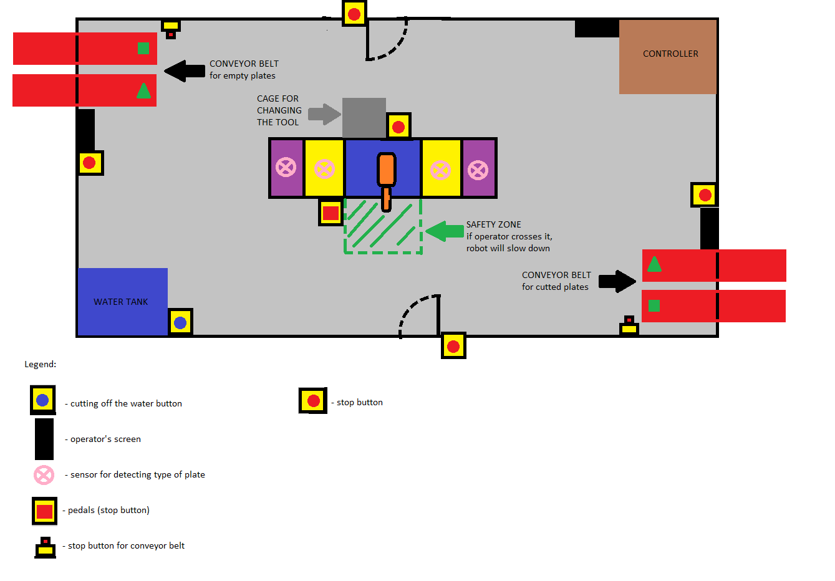

Slide 3
Explanation
The cage presented above is created for
workers. One of them place the empty plates
on the working areas of the robot, the other
take the cutted plates and put them on
conveyor belt. We placed some safety solutions
in their working place to make their work more
secure.

Slide 4
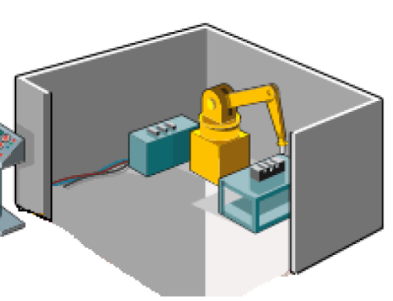
Cage
We place the robot inside the cage, so as only
its workers can go inside and to minimize the
risk of injury for other people.

Slide 5

Safety zones
The dangers are where the robot is moving.
That is why we decided to place safety zones in
area where robot works. If the worker steps
inside the zone, the robot will slow down.

Slide 6
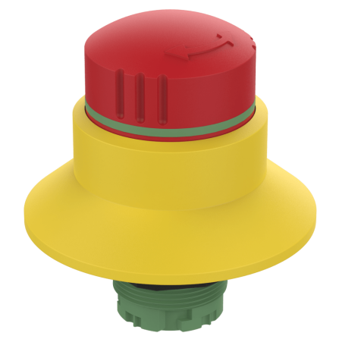

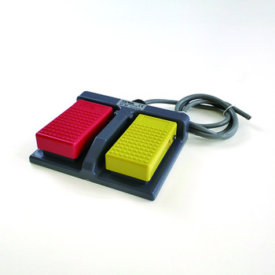

Absolute stop pedal and buttons
In case of emergency the workers can stop the
movements of the robot. The buttons and
pedals stop the electricity and work of the
conveyor belts, cut off water.

Slide 7
Stop button only for conveyor belt
If something wrong happens only with
conveyor belt there is no need to turn off the
whole system. That is why we put „stop the
conveyor belt buttons” next to them.

Slide 8
Cut off the water button
The action of the button is similar to the
previous one but it only stops the flow of the
water. It is placed next to the water tank.

Slide 9
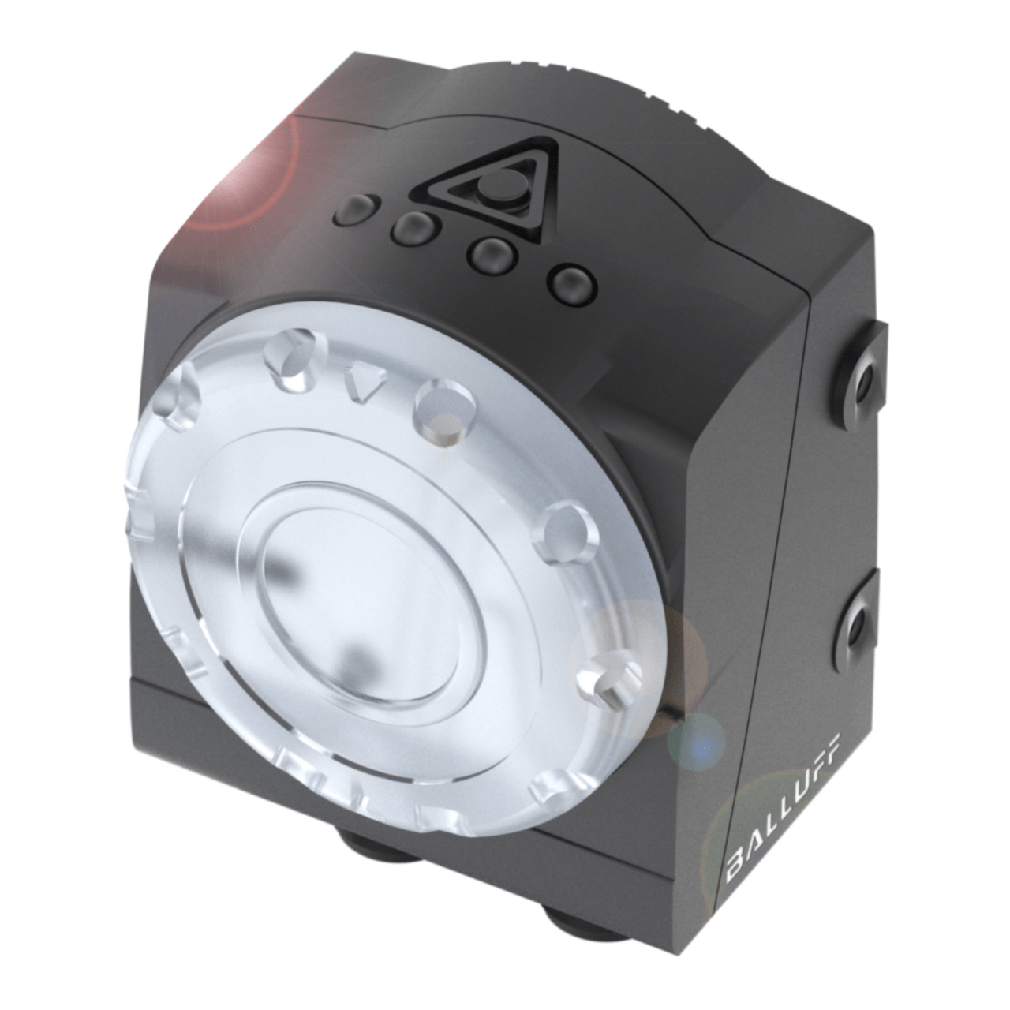
Sensors for detecting the types of plates
They are placed on the ceiling right above the
area where the plates are putted. In case the
worker put the wrong plate, the sensor notices
it and stop the system until the plate is
correct. Also the worker will hear sound signal
and see the command on operator window.
The sensor also detects the forgein body in the
working area (like hand etc.). If that happens
the system stops abruptly.

Slide 10
Doors safety
There is no need to place any kind of sensors
to lock the door. The workers are inside so it
might complicate the escape in case of
emergency. The only requirement is that only
authorized person (operator) is allowed to go
inside.

Slide 11
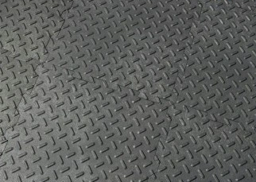
The floor
Floor inside tha cage is made from anti-slipes
tiles in case the water drops outside the
working zone. In this way the worker will not
slip if he/she doesn’t notice that.

Slide 12

The cage for changing tool
We put the cage on the changing tool position
so as to protect the worker from any harm
during this action.

Slide 13
APPLICATION ACCORDING TO NORMA EN ISO 13849

Slide 14
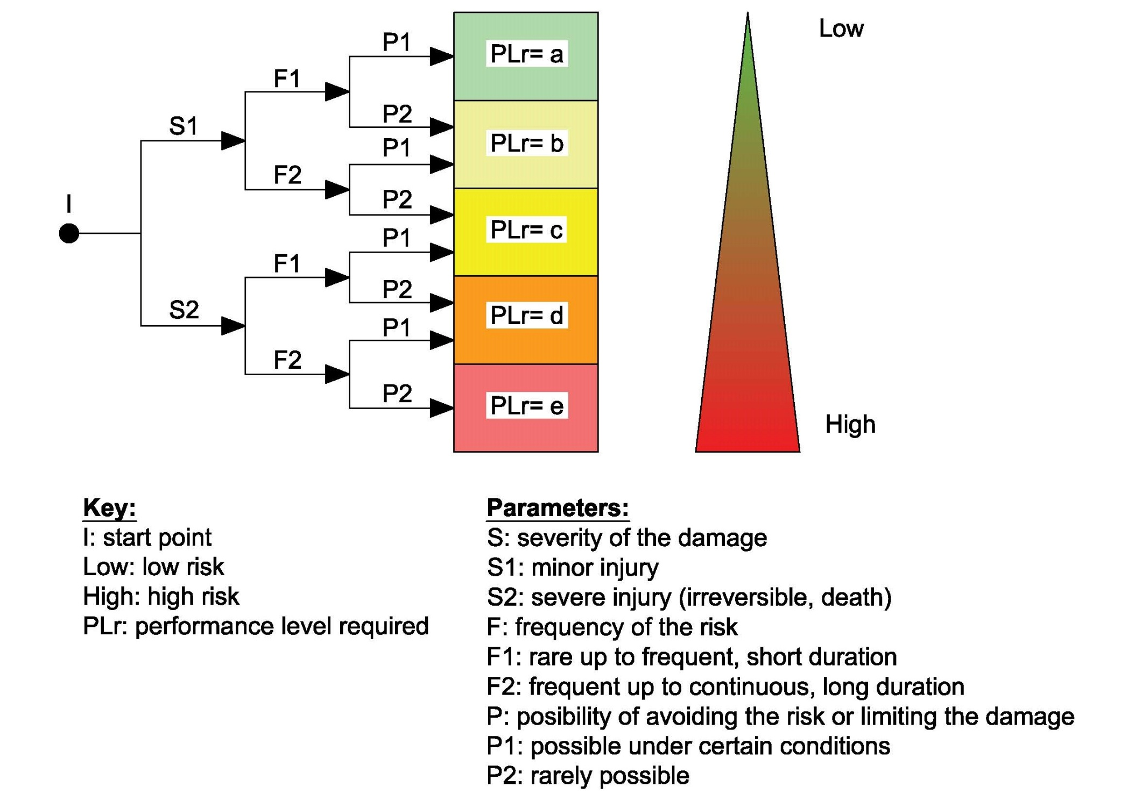
Case1:
Hitting by the robot

Slide 15
Explanation
Case 1: hitting by the robot We calculate the risk of that as „b”. It is because you can only be hitted by a robot when it doesn’t work. We also used safety zones in our cage that should prevent from that. The velocity of the movements of robot are also not so fast to cause any damage for the operator.

Slide 16
Case2:
Sliding on the water

Slide 17
Explanation
Case 2: sliding on the water We calculate the risk of that as „a”. It in nearly impossible to slide in our cage as we use anti-slide floor. We also placed the emergency buttons that will cut off the water in case of the leak. Other buttons also stop the flow of the water. We also reqiuire from the worker to wear convinient shoes.

Slide 18
Case3:
Injury caused by the robot jet

Slide 19
Explanation
Case 3: Injury caused by the robot jet We calculate the risk of that as „d”. Comparing to the previous dangers this one is the most dangerous. It can cause the irreversible harm. It happens when the operator put his hand in front of the jet while the robot is working. We tried to prevent from that by using commends on the operator window so it could only happen when operator doesn’t follow them.

Slide 20
Case4:
Falling on the working area of the robot

Slide 21
Explanation
Case 4: Falling on the working area of the
robot
We calculate the risk of that as „c”. We placed
the sensor that should stop the movement of
the robot if they detect a thing that has
different shape than the plates. It can only
happen by accident so we also require from the
worker to be focused on the task.

Slide 22
Conclusion
The cage that we designed doesn’t belong to
the cheapest options but it is really safe. We
used advanced technology to protect the
workers but we also put 2 of them in one cage
to increase the security. In case of the accident
one of them can help the other one by using
first aid. We considered our working place as
not so dangerous, beacuse the highest level of
risk is „d” and this case is unluckily to happen.

